Slide 1
More on SQL
Presented by
Prof. Dr. Taysir Hassan Adbel Hamid
Information Systems Department
Faculty of Computers and Information
Assiut University
March 29, 2020

Slide 2
Oultine
INSERT, UPDATE, DELETE
Nested Queries
IN
EXISTS and Not EXISTS
Views

Slide 3
Relational Update Operations
Each relation will have many tuples in its current relation state
The relational database state is a union of all the individual relation states at a particular time
Whenever the database is changed, a new state arises
Basic operations for changing the database:
INSERT new tuples in a relation
DELETE existing tuples from a relation
UPDATE attribute values of existing tuples

Slide 4
Operations to Modify Relations
Three basic operations:
INSERT
DELETE
UPDATE
Integrity constraints should not be violated by the update operations.
Several update operations may have to be grouped together into a transaction.
Updates may propagate to cause other updates automatically. This may be necessary to maintain integrity constraints.

Slide 5
Operations (cont.)
In case of integrity violation, several actions can be taken:
Cancel the operation that causes the violation (RESTRICT or REJECT option)
Perform the operation but inform the user of the violation
Trigger additional updates so the violation is corrected (CASCADE option, SET NULL option)
Execute a user-specified error-correction routine

Slide 6
INSERT operation
INSERT one or more new tuples into a relation
INSERT may violate any of the constraints:
Domain constraint:
if one of the attribute values provided for a new tuple is not of the specified attribute domain
Key constraint:
if the value of a key attribute in a new tuple already exists in another tuple in the relation
Referential integrity:
if a foreign key value in a new tuple references a primary key value that does not exist in the referenced relation
Entity integrity:
if the primary key value is null in a new tuple

Slide 7
DELETE operation
DELETE one or more existing tuples from a relation
DELETE may violate only referential integrity:
If the primary key value of the tuple being deleted is referenced from other tuples in the database
Can be remedied by several actions: RESTRICT, CASCADE, SET NULL (see Chapter 4 for more details)
RESTRICT option: reject the deletion
CASCADE option: propagate the deletion by automatically deleting the referencing tuples
SET NULL option: set the foreign keys of the referencing tuples to NULL (the foreign keys cannot have NOT NULL constraint)
One of the above options must be specified during database design for each referential integrity (foreign key) constraint

Slide 8
UPDATE operation
UPDATE modifies the values of attributes in one or more existing tuples in a relation
UPDATE may violate domain constraint and NOT NULL constraint on an attribute being modified
Other constraints may also be violated:
Updating the primary key (PK):
Similar to a DELETE followed by an INSERT
Need to specify similar options to DELETE
The CASCADE option propagates the new value of PK to the foreign keys of the referencing tuples automatically
Updating a foreign key (FK) may violate referential integrity
Updating an ordinary attribute (neither PK nor FK):
Can only violate domain or NOT NULL constraints

Slide 9
SQL Statements for Updating the Database
There are three SQL commands to modify the database: INSERT, DELETE, and UPDATE
INSERT is used for adding one or more records to a table
DELETE is for removing records
UPDATE is for modifying existing records
Some operations may be rejected if they violate integrity constraints; others may propagate additional updating automatically if specified in the database schema

Slide 10
INSERT statement
Used to add one or more tuples (records) to a relation (table)
Values for the attributes should be listed in the same order as the attributes were specified in the CREATE TABLE command
Attributes that have defaults values can be omitted in the new record(s)

Slide 11
INSERT statement (cont.)
Example:
U1: INSERT INTO EMPLOYEE VALUES ('Richard','K','Marini', '653298653', '30-DEC-52', '98 Oak Forest,Katy,TX', 'M', 37000,'987654321', 4 ) ;
An alternate form of INSERT specifies explicitly the attribute names that correspond to the values in the new tuple
Attributes with NULL or default values can be left out
Example: Insert a tuple for a new EMPLOYEE for whom we only know the FNAME, LNAME, and SSN attributes.
U1A: INSERT INTO EMPLOYEE (FNAME, LNAME, SSN) VALUES ('Richard', 'Marini', '653298653') ;

Slide 12
INSERT statement (cont.)
Constraints specified in the DDL are automatically enforced by the DBMS when updates are applied to the database
Can insert multiple tuples in one INSERT statement
The values in each tuple are enclosed in parentheses

Slide 13
INSERT statement (cont.)
Can also insert tuples from a query result into a table
Example: Suppose we want to create a temporary table that has the employee last name, project name, and hours per week for each employee.
A table WORKS_ON_INFO is created by U3A, and is loaded with the summary information retrieved from the database by the query in U3B.
U3A: CREATE TABLE WORKS_ON_INFO (EMP_NAME VARCHAR(15), PROJ_NAME VARCHAR(15), HOURS_PER_WEEK DECIMAL(3,1));
U3B: INSERT INTO WORKS_ON_INFO (EMP_NAME, PROJ_NAME, HOURS_PER_WEEK) SELECT E.LNAME, P.PNAME, W.HOURS FROM EMPLOYEE E, PROJECT P, WORKS_ON W WHERE E.SSN=W.ESSN AND W.PNO=P.PNUMBER ;

Slide 14
INSERT statement (cont.)
Note: The WORKS_ON_INFO table may not be up-to-date if we change the tuples in the WORKS_ON, PROJECT, or EMPLOYEE relations after executing U3B.
We have to use CREATE VIEW (see Chapter 5) to keep such a table up to date.

Slide 15
DELETE Statement
Removes tuples from a relation
Includes a WHERE-clause to select the tuples to be deleted
Referential integrity should be enforced (via REJECT/RESTRICT, CASCADE, SET NULL, or SET DEFAULT)
Tuples are deleted from only one table at a time (unless CASCADE is specified on a referential integrity constraint)
Missing WHERE-clause deletes all tuples in the relation; the table then becomes an empty table
Number of tuples deleted is the number of tuples selected by the WHERE-clause

Slide 16
DELETE Statement (cont.)
Examples:
U4A: DELETE FROM EMPLOYEE WHERE LNAME='Brown' ;
U4B: DELETE FROM EMPLOYEE WHERE SSN='123456789’ ;
U4C: DELETE FROM EMPLOYEE WHERE DNO = 5 ;
U4D: DELETE FROM EMPLOYEE ;

Slide 17
UPDATE Statement
Used to modify attribute values of one or more selected tuples
A WHERE-clause selects the tuples to be modified
An additional SET-clause specifies the attributes to be modified and their new values
Each command modifies tuples in the same relation
Referential integrity should be enforced (via REJECT/RESTRICT, CASCADE, SET NULL, or SET DEFAULT)

Slide 18
UPDATE Statement (cont.)
Example: Change the location and controlling department number of project number 10 to 'Bellaire' and 5, respectively.
U5: UPDATE PROJECT SET PLOCATION = 'Bellaire', DNUM = 5 WHERE PNUMBER=10 ;

Slide 19
UPDATE Statement (cont.)
Example: Give all employees in department number 5 a 10% raise in salary
U6: UPDATE EMPLOYEE SET SALARY = SALARY *1.1 WHERE DNO = 5 ;
In this request, the modified SALARY value depends on the original SALARY value in each tuple
The reference to the SALARY attribute on the right of = refers to the old SALARY value before modification
The reference to the SALARY attribute on the left of = refers to the new SALARY value after modification

Slide 20
Set and Multiset Operations in SQL
SQL has directly incorporated some set operations
The set operations are: union (UNION), set difference (EXCEPT or MINUS) and intersection (INTERSECT)
Results of these set operations are sets of tuples; duplicate tuples are eliminated from the result
Set operations apply only to type compatible relations (also called union compatible); the two relations must have the same (or similar) attribute types and in the same order
Set operations typically applied to the results of two separate queries; e.g Q1 UNION Q2

Slide 21
Set Operations (cont.)
Example: Query 4: Make a list of all project names for projects that involve an employee whose last name is 'Smith' as a worker on the project or as a manager of the department that controls the project.
Q4: (SELECT PNAME FROM PROJECT, DEPARTMENT, EMPLOYEE WHERE DNUM=DNUMBER AND MGRSSN=SSN AND LNAME='Smith') UNION
(SELECT PNAME FROM PROJECT, WORKS_ON, EMPLOYEE WHERE PNUMBER=PNO AND
ESSN=SSN AND LNAME='Smith') ;

Slide 22
Multiset Operations in SQL
SQL has multiset operations when the user does not want to eliminate duplicates from the query results
These are: UNION ALL, EXCEPT ALL, and INTERSECT ALL; see examples in Figure 4.5 (next slide)
Results of these operations are multisets of tuples; all tuples and duplicates in the input tables are considered when computing the result
Multiset operations also apply only to type compatible relations
Typically applied to the results of two separate queries; e.g Q1 UNION ALL Q2 ;

Slide 24
Some Other Features of SQL
More complex query features: nested queries, aggregate functions, GROUP BY, HAVING, EXISTS function
Views,
Database Security

Slide 25
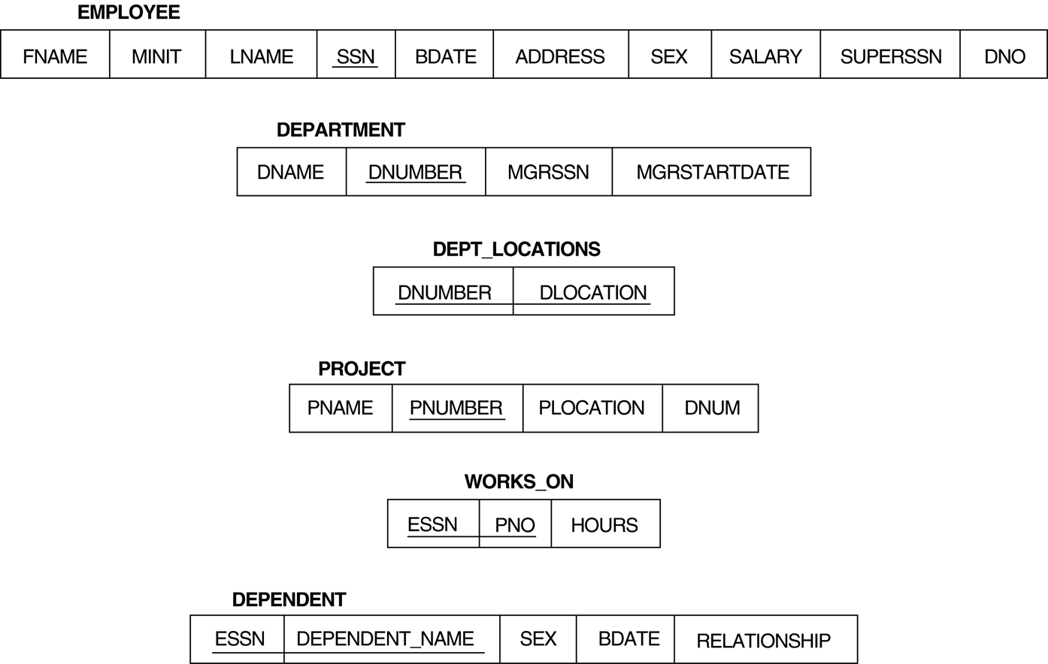
The COMPANY Database Schema

Slide 26
Specifying Updates in SQL
There are three SQL commands to modify the database; INSERT, DELETE, and UPDATE

Slide 27
INSERT
In its simplest form, it is used to add one or more tuples to a relation
Attribute values should be listed in the same order as the attributes were specified in the CREATE TABLE command

Slide 28
INSERT (cont.)
Example: QUERY : INSERT INTO EMPLOYEE VALUES (‘Aly’,'K',‘ElGohary', '653298653', '30-DEC-52', ‘7 ElGomherya Street', 'M', 37000,'987654321', 4 )
An alternate form of INSERT specifies explicitly the attribute names that correspond to the values in the new tuple
Attributes with NULL values can be left out
Query : Insert a tuple for a new EMPLOYEE for whom we only know the FNAME, LNAME, and SSN attributes. INSERT INTO EMPLOYEE (FNAME, LNAME, SSN) VALUES (‘Aly', ‘ElGohary', '653298653')

Slide 29
INSERT (cont.)
Note: The DEPTS_INFO table may not be up-to-date if we change the tuples in either the DEPARTMENT or the EMPLOYEE relations after issuing the last query. We have to create a view (see later) to keep such a table up to date.

Slide 30
DELETE
Removes tuples from a relation
Includes a WHERE-clause to select the tuples to be deleted
Tuples are deleted from only one table at a time (unless CASCADE is specified on a referential integrity constraint)
A missing WHERE-clause specifies that all tuples in the relation are to be deleted; the table then becomes an empty table
The number of tuples deleted depends on the number of tuples in the relation that satisfy the WHERE-clause
Referential integrity should be enforced

Slide 31
DELETE (cont.)
Examples:
U4A: DELETE FROM EMPLOYEE WHERE LNAME='Brown’ U4B: DELETE FROM EMPLOYEE WHERE SSN='123456789’ U4C: DELETE FROM EMPLOYEE

Slide 32
UPDATE
Used to modify attribute values of one or more selected tuples
A WHERE-clause selects the tuples to be modified
An additional SET-clause specifies the attributes to be modified and their new values
Each command modifies tuples in the same relation
Referential integrity should be enforced

Slide 33
UPDATE (cont.)
Example: Change the location and controlling department number of project number 10 to ‘Cairo' and 5, respectively. U5: UPDATE PROJECT SET PLOCATION = ‘Cairo', DNUM = 5 WHERE PNUMBER=10

Slide 34
Arithmetic Operations
The standard arithmetic operators '+', '-'. '*', and '/' can be applied to numeric values in an SQL query result
Example 1: Show the effect of a 10% pay raise on all employees.
SELECT Fname, Lame, 1.1*Salary FROM EMPLOYEE;
List the names of those employees whose salary would exceed $100,000 if given a 20% + $5000 pay raise.
SELECT Fname, Lname FROM EMPLOYEE WHERE (Salary*1.2 + 5000) >= 100000;

Slide 35
NESTING OF QUERIES
A complete SELECT query, called a nested query , can be specified within the WHERE-clause of another query, called the outer query
Many of the previous queries can be specified in an alternative form using nesting
Query : Retrieve the name and address of all employees who work for the 'Research' department. Q1: SELECT FNAME, LNAME, ADDRESS FROM EMPLOYEE WHERE DNO IN (SELECT DNUMBER FROM DEPARTMENT WHERE DNAME='Research' )

Slide 36
NESTING OF QUERIES (cont.)
The nested query selects the number of the 'Research' department
The outer query select an EMPLOYEE tuple if its DNO value is in the result of either nested query
The comparison operator IN compares a value v with a set (or multi-set) of values V, and evaluates to TRUE if v is one of the elements in V
In general, we can have several levels of nested queries
A reference to an unqualified attribute refers to the relation declared in the innermost nested query
In this example, the nested query is not correlated with the outer query

Slide 37
THE EXISTS FUNCTION
Query : Retrieve the name of each employee who has a dependent with the same first name as the employee. QB: SELECT FNAME, LNAME FROM EMPLOYEE WHERE EXISTS (SELECT * FROM DEPENDENT WHERE SSN=ESSN AND FNAME=DEPENDENT_NAME)

Slide 38
THE EXISTS FUNCTION (cont.)
Query : Retrieve the names of employees who have no dependents. Q: SELECT FNAME, LNAME FROM EMPLOYEE WHERE NOT EXISTS (SELECT * FROM DEPENDENT WHERE SSN=ESSN)
In the above query, the correlated nested query retrieves all DEPENDENT tuples related to an EMPLOYEE tuple. If none exist , the EMPLOYEE tuple is selected
EXISTS is necessary for the expressive power of SQL

Slide 39
EXPLICIT SETS
It is also possible to use an explicit (enumerated) set of values in the WHERE-clause rather than a nested query
Query : Retrieve the social security numbers of all employees who work on project number 1, 2, or 3.
SELECT DISTINCT ESSN FROM WORKS_ON WHERE PNO IN (1, 2, 3)

Slide 40
Nesting OF Queries
A complete SELECT query, called a nested query, can be specified within the WHERE-clause of another query, called the outer query
Example: Retrieve the name and address of all employees who work for the 'Research' department.
SELECT Fname, Lname, Address FROM EMPLOYEE WHERE Dno IN (SELECT Dnumber FROM DEPARTMENT WHERE
Dname='Research');
NOT IN can also be used.

Slide 41
Correlated Nested Queries
If a nested query references an attribute of a relation in the outer query, the two queries are said to be correlated.
A reference to an unqualified attribute refers to the relation in the innermost nested query
Attributes from the outer query must be qualified in the inner query.
Example: Retrieve the name of each employee who has a dependent with the same first name as the employee.
SELECT E.Fname, E.Lname FROM EMPLOYEE AS E WHERE SSN IN (SELECT Essn FROM DEPENDENT WHERE Essn=E.SSN AND E.Fname=DEPENDENT.Name)

Slide 42
NULLS IN SQL QUERIES
SQL allows queries that check if a value is NULL (missing or undefined or not applicable)
SQL uses IS or IS NOT to compare NULLs because it considers each NULL value distinct from other NULL values, so equality comparison is not appropriate .
Query : Retrieve the names of all employees who do not have supervisors. SELECT FNAME, LNAME FROM EMPLOYEE WHERE SUPERSSN IS NULL Note: If a join condition is specified, tuples with NULL values for the join attributes are not included in the result

Slide 43
UPDATE with the IN Operator
Example: Give all employees in the 'Research' department a 10% raise in salary.
UPDATE EMPLOYEE SET SALARY = SALARY *1.1 WHERE Dno IN (SELECT Dnumber FROM DEPARTMENT WHERE Dname='Research');

Slide 44
The IN Operator Explained
The operator IN tests a value v exists in the results of an inner query. It is equal to operator “= Any”
A similar operator is “= All” Can you guess its meaning ?
We also have “> Any”, “<= All”, …
NOT IN is equivalent to ?
Simply put, IN and NOT IN are both comparison operators that produces Boolean results. They can be used with other Boolean operators to form complex expressions.
Example: name the eldest employee.
SELECT Fname, Lname
FROM EMPLOYEE
WHERE Bdate >= ALL (Select Bdate from EMPLOYEE);

Slide 45
AGGREGATE FUNCTIONS
Include COUNT, SUM, MAX, MIN, and AVG
Query : Find the maximum salary, the minimum salary, and the average salary among all employees. SELECT MAX(SALARY), MIN(SALARY), AVG(SALARY) FROM EMPLOYEE
Some SQL implementations may not allow more than one function in the SELECT-clause

Slide 46
AGGREGATE FUNCTIONS (cont.)
Query : Find the maximum salary, the minimum salary, and the average salary among employees who work for the 'Research' department. SELECT MAX(SALARY), MIN(SALARY), AVG(SALARY) FROM EMPLOYEE, DEPARTMENT WHERE DNO=DNUMBER AND DNAME='Research'

Slide 47
AGGREGATE FUNCTIONS (cont.)
Queries: Retrieve the total number of employees in the company, and the number of employees in the 'Research' department . SELECT COUNT (*) FROM EMPLOYEE SELECT COUNT (*) FROM EMPLOYEE, DEPARTMENT WHERE DNO=DNUMBER AND DNAME='Research’

Slide 48
Aggregate Functions
COUNT, SUM, MAX, MIN, and AVG
Example 1: Find the maximum salary, the minimum salary, and the average salary among all employees.
SELECT MAX(SALARY), MIN(SALARY), AVG(SALARY) FROM EMPLOYEE;
Example 2: Find the max/min/avg salaries among employees who work for the 'Research' department.
SELECT MAX(SALARY), MIN(SALARY), AVG(SALARY) FROM EMPLOYEE, DEPARTMENT WHERE Dno=Dnumber && Dname='Research';

Slide 49
Aggregate Functions (contd.)
Examples: Retrieve the total number of employees in the company (Q1), and the number of employees in the 'Research' department (Q2).
Q1: SELECT COUNT (*) FROM EMPLOYEE
Q2: SELECT COUNT (*) FROM EMPLOYEE, DEPARTMENT WHERE Dno=Dnumber AND Dname='Research’
All aggregate functions are computed after WHERE
aggregate functions themselves cannot be used in WHERE

Slide 50
Discussions
Which one of the following queries produces the correct salary budget for the company.
Select SUM(Salary) from EMPLOYEE;
Select SUM(distinct Salary) from EMPLOYEE;

Slide 51
GROUPING
A GROUP BY clause can be used to specify the grouping attributes, so that we apply the aggregate functions to subgroups of tuples in a relation
For each department, retrieve the department number, the number of employees in the department, and their average salary.
SELECT Dno, COUNT(*), AVG(SALARY) FROM EMPLOYEE GROUP BY Dno;
This is identical to the relational algebra expression
_{DNO} ℱ_{COUNT SSN, AVERAGE Salary} (EMPLOYEE)

Slide 52
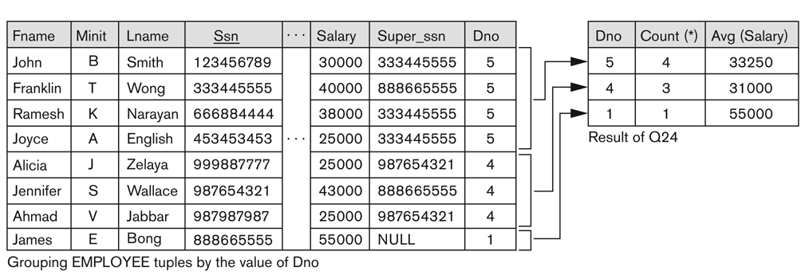
Grouping by Dno

Slide 53
GROUPING (contd.)
For each project, retrieve the project number, project name, and the number of employees who work on that project.
SELECT Pnumber, Pname, COUNT(*) FROM PROJECT, WORKS_ON WHERE Pnumber=Pno GROUP BY Pnumber, Pname;
In this case, the grouping and functions are applied after the joining of the two relations

Slide 54
The HAVING Clause
Sometimes we want to retrieve the values of these functions for only those groups that satisfy certain conditions
The HAVING clause is used for specifying a selection condition on groups (rather than on individual tuples)
This solves the restrictions that aggregate functions cannot be used in the WHERE clause.

Slide 55
THE HAVING-CLAUSE (contd.)
Example: For each project on which more than two employees work, retrieve the project number, project name, and the number of employees who work on that project.
SELECT Pnumber, Pname, COUNT(*)
FROM PROJECT, WORKS_ON
WHERE Pnumber=Pno
GROUP BY Pnumber, Pname
HAVING COUNT(*) > 2;

Slide 56
The ORDER BY Clause
The ORDER BY clause is used to sort the tuples in a query result based on the values of some attribute(s)
Example: List all employees in the alphabetic order of last names; for the same last names, ordered by first names; given the same last and first names, ordered by SSN;
Select *
From EMPLOYEE
Order By Lname, Fname, SSN;

Slide 57
ORDER BY (contd.)
The default order is in ascending order of values
We can specify the keyword DESC if we want a descending order; the keyword ASC can be used to explicitly specify ascending order, even though it is the default
Select *
From EMPLOYEE
Order By Lname ASC,
Fname ASC,
SSN DESC;

Slide 58
Summary of SQL Queries
A query in SQL can consist of up to six clauses, but only the first two, SELECT and FROM, are mandatory. The clauses are specified in the following order: SELECT <attribute list> FROM <table list> [WHERE <condition>] [GROUP BY <grouping attribute(s)>] [HAVING <group condition>] [ORDER BY <attribute list>]

Slide 59
Data Definition, Constraints, and Schema Changes
Used to CREATE, DROP, and ALTER the descriptions of the tables (relations) of a database

Slide 60
DROP TABLE
Used to remove a relation (base table) and its definition
The relation can no longer be used in queries, updates, or any other commands since its description no longer exists
Example: DROP TABLE DEPENDENT;

Slide 61
ALTER TABLE
Used to add an attribute to one of the base relations
The new attribute will have NULLs in all the tuples of the relation right after the command is executed; hence, the NOT NULL constraint is not allowed for such an attribute
Example: ALTER TABLE EMPLOYEE ADD JOB VARCHAR(12);
The database users must still enter a value for the new attribute JOB for each EMPLOYEE tuple. This can be done using the UPDATE command.

Slide 62
REFERENTIAL INTEGRITY OPTIONS
We can specify RESTRICT, CASCADE, SET NULL or SET DEFAULT on referential integrity constraints (foreign keys) CREATE TABLE DEPT ( DNAME VARCHAR(10) NOT NULL, DNUMBER INTEGER NOT NULL, MGRSSN CHAR(9), MGRSTARTDATE CHAR(9), PRIMARY KEY (DNUMBER), UNIQUE (DNAME), FOREIGN KEY (MGRSSN) REFERENCES EMP ON DELETE SET DEFAULT ON UPDATE CASCADE );

Slide 63
REFERENTIAL INTEGRITY OPTIONS (continued)
CREATE TABLE EMP ( ENAME VARCHAR(30) NOT NULL, ESSN CHAR(9), BDATE DATE, DNO INTEGER DEFAULT 1, SUPERSSN CHAR(9), PRIMARY KEY (ESSN), FOREIGN KEY (DNO) REFERENCES DEPT ON DELETE SET DEFAULT ON UPDATE CASCADE, FOREIGN KEY (SUPERSSN) REFERENCES EMP ON DELETE SET NULL ON UPDATE CASCADE );

Slide 64
Combining Results Tables
Requirements: tables need to have same structure so they’re union-compatible
Sometimes its useful to be able to combine query results using set operations:
R U S
R ∩ S
R - S
R
R
R
S
S
S
(a) Union
(b) Intersection
(c) Difference (Except)

Slide 65
Set Operators
SQL has directly incorporated some set operations
There is a union operation (UNION), and in some versions of SQL there are set difference (MINUS) and intersection (INTERSECT) operations
Oracle and MySQL support only UNION
The resulting relations of these set operations are sets of tuples; duplicate tuples are eliminated from the result
The set operations apply only to union compatible relations; the two relations must have the same attributes and the attributes must appear in the same order

Slide 66
Example
Make a list of all project numbers for projects that involve an employee whose last name is 'Smith' as a worker or as a manager of the department that controls the project.
(SELECT Pname from PROJECT, DEPARTMENT, EMPLOYEE where Dnum=Dnumber AND mgrssn=ssn AND Lname='Smith')
UNION
(Select Pname from PROJECT, WORKS_ON, EMPLOYEE where Pnumber=Pno AND Essn=Ssn AND Lname='Smith')

Slide 67
What are Views?
A view is a virtual table, constructed from base tables
Why would we want to do this?
Only the definition of a view is stored permanently (as a query)
A view is realised dynamically when it is first referenced
3 types of views: horizontal, vertical, grouped/joined
Views are manipulated like other DBMS objects:
CREATE VIEW ViewName ... (next slide)
DROP VIEW ViewName

Slide 68
General Syntax for Creating & Dropping a View
CREATE VIEW name [(new column names)] AS SELECT …
CREATE VIEW Locations AS
SELECT fName, lName, dept, bldg
FROM PhoneBook, Department
WHERE dept = Department.name
DROP VIEW ViewName [RESTRICT|CASCADE]

Slide 69
Creating Views - Horizontal Views
A horizontal view restricts the rows that may be seen:
CREATE VIEW Manager3Staff AS (subselect)
SELECT * FROM Staff WHERE BranchNo = 'B003'; (defining query)
Then...
SELECT * FROM Manager3Staff gives result;
So now branch manager can only see details of her own branch
Manager3Staff
StaffNo | Fname | Lname | Position | Gender | Salary | BranchNo
SG37 | Ann | Beech | Assistant | F | 12000 | B003
SG5 | Susan | Brand | Manager | F | 24000 | B003

Slide 70
Thank you

